Slide 1
Timetable Management System
BY
Sheryar Ahmed FA21-BCE-042
Muhammad Hassan FA21-BCE-050
Hasnain Hafeez FA21-BCE-036
SEMESTER PROJECT | OBJECT ORIENTRED PROGRAMMING

Slide 2
Outline:
Introduction
Literature Review
Methodology
Results
Teamwork / Task Division
Timeline
Learning
Conclusion

Slide 3
Brief Introduction
This project is basically a timetable generator in Java.
It has three interface i.e., Administration, Teachers, and Students.
Administration can generate new timetables and can see both faculty and student timetables.
The Teachers interface displays a timetable for a given teacher i.e., all the sections are in the table where he/she has a lecture. Teachers can select their name from the options.
The Students interface displays a timetable for a given class (section) i.e., all the subjects/teachers are mentioned in the table according to their lecture timings. Students can select different sections from the options.

Slide 4
Literature Review:
We studied the Constraint Satisfaction Problem and the Greedy Algorithm for this project.
Since there was a greater level of understanding required for implementing these algorithms, we decided to develop our own logic which incorporates some their characteristics.

Slide 5
Motivation:
Most Java projects are about Management Systems that require the basic knowledge of Object-Oriented Programming.
We wanted to do something challenging that incorporated logic development and critical thinking as well.
The key motivation behind this project was to improve our problem-solving skills which are much needed in the long run.

Slide 6
Applications:
It is basically a scheduling system, and its applications are as follows:
Educational Institutes: Schools, Colleges, and Universities use scheduling systems to generate timetables for classes.
Offices: Offices can use this system to generate timings for meetings and tasks etc.
Miscellaneous: Any person can use this project to generate a daily life schedule or tasks schedule as well.

Slide 7
Methodology:
Timetable Generation:
One teacher will be filled in all the 2D arrays at a time according to number of lectures.
Those 2D arrays will be stored in a 3D array.
Indexes for the teacher will be generated randomly.
The validity of those indexes will be checked before assigning them to avoid clashes.
If the indexes are not valid, new ones will be generated.
If number of attempts at index generation exceed 10 million times, the program will start from the scratch with new values.
This method of starting over will at most continue ten times and then a message will be printed in the console saying that clash cannot be resolved.

Slide 8
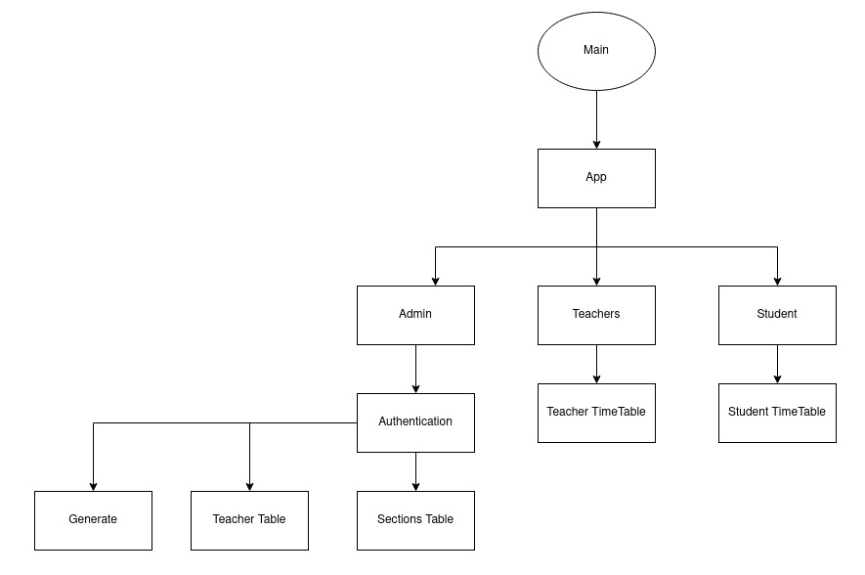
Methodology:
Block Diagram:

Slide 9
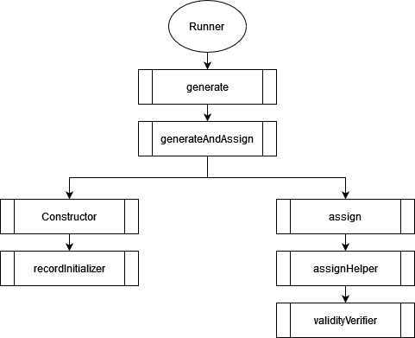
Methodology: Hierarchy of Timetable Generation:

Slide 10
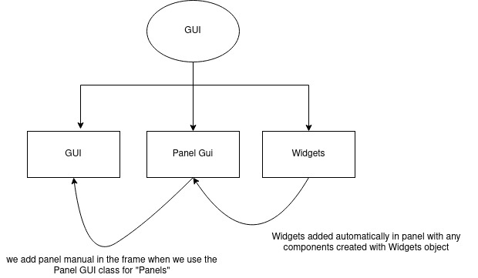
Methodology: Hierarchy of GUI Class:

Slide 11
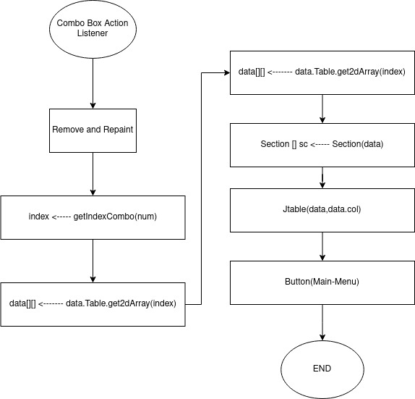
Methodology: Hierarchy of Combox Action Listener:

Slide 12
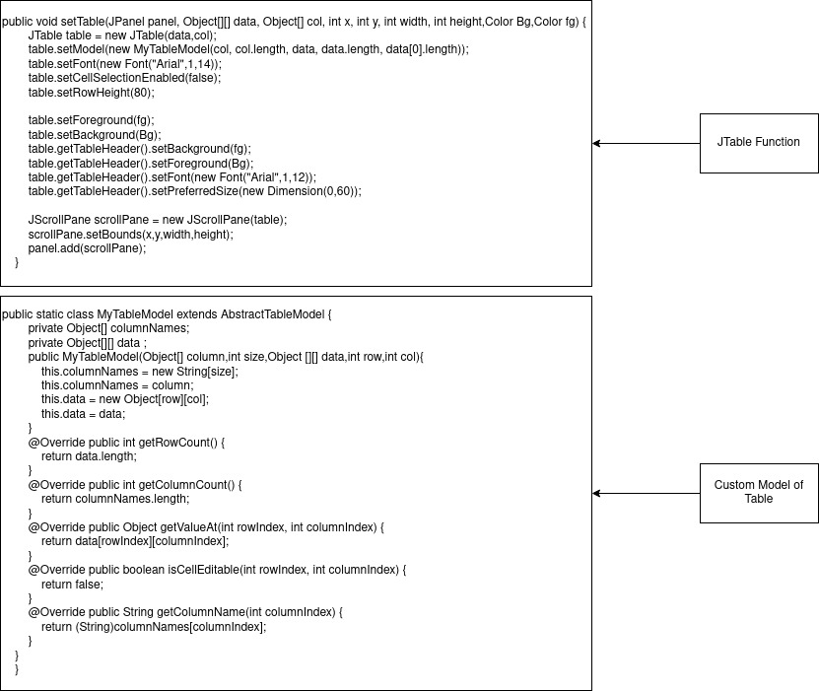
Methodology: Code of JTable and custom model :

Slide 13
Methodology: Advantages:
Accuracy: This program is highly accurate in generating random timetables.
Time Efficiency: It saves a lot of time. If we have a large amount of data, we cannot generate schedules manually. This program does the job in a few seconds.
Easy to Use: The interface is user friendly and easy to use.

Slide 14
Methodology: Potential Disadvantages:
Lack of features:
This program generates a timetable for all the classes at the same time i.e., we cannot generate a timetable for a specific class in this version.
We cannot change the lecture timing of one teacher without affecting others because those functionalities have not been added yet.
The user interface has limited capabilities.

Slide 15
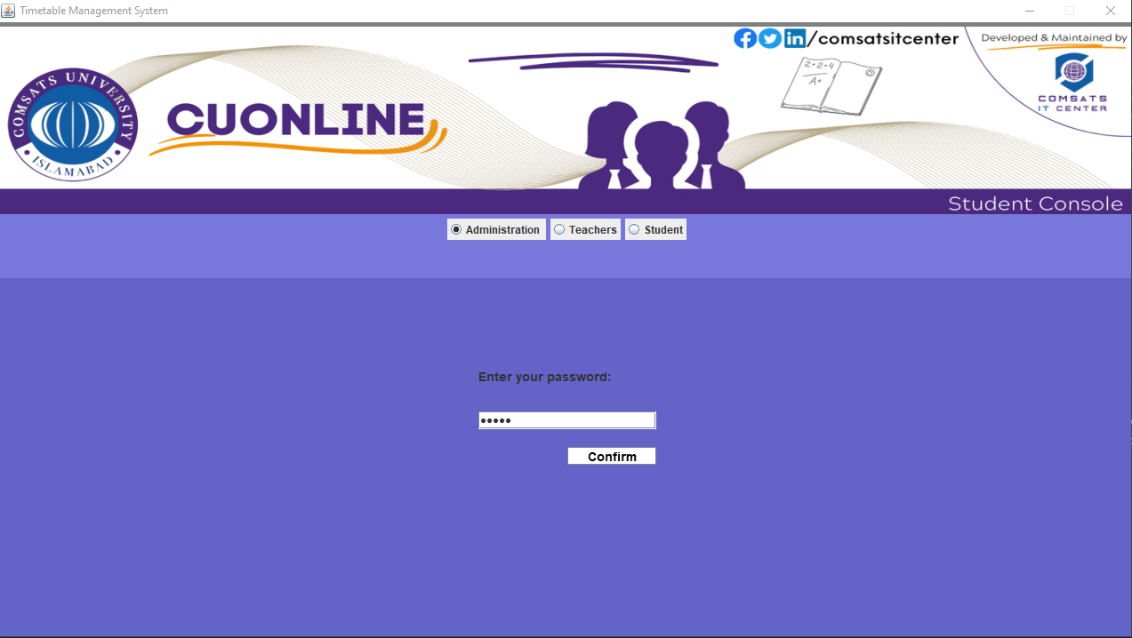
Results Main Interface:

Slide 16
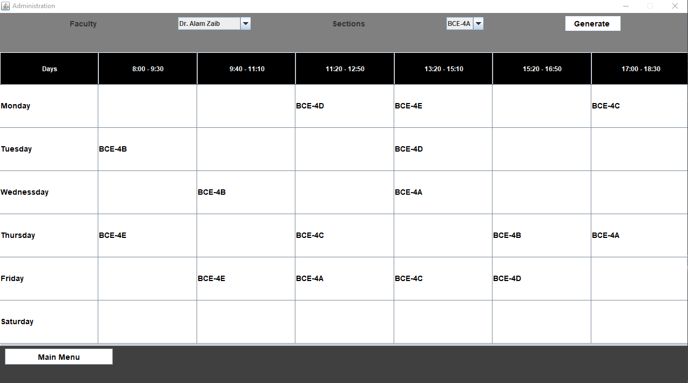
Result of Admin with Teacher Timetable:

Slide 17
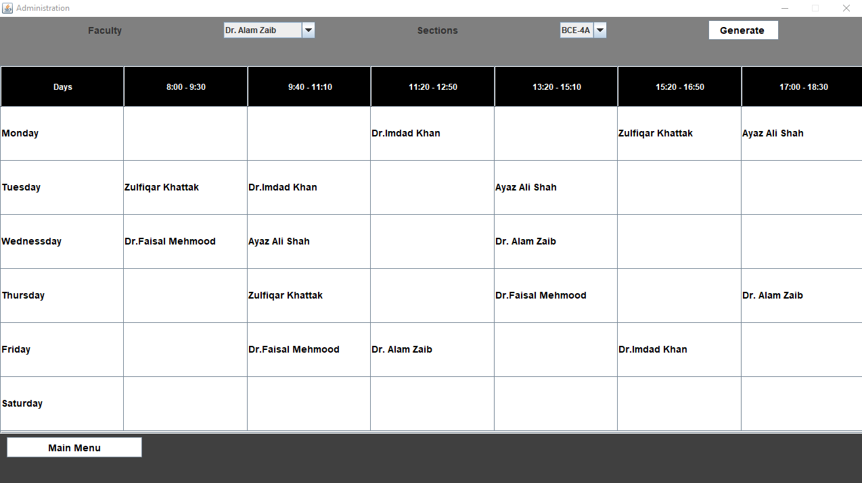
Result of Admin with Section Timetable:

Slide 18
Result of Admin After Random Table:

Slide 19
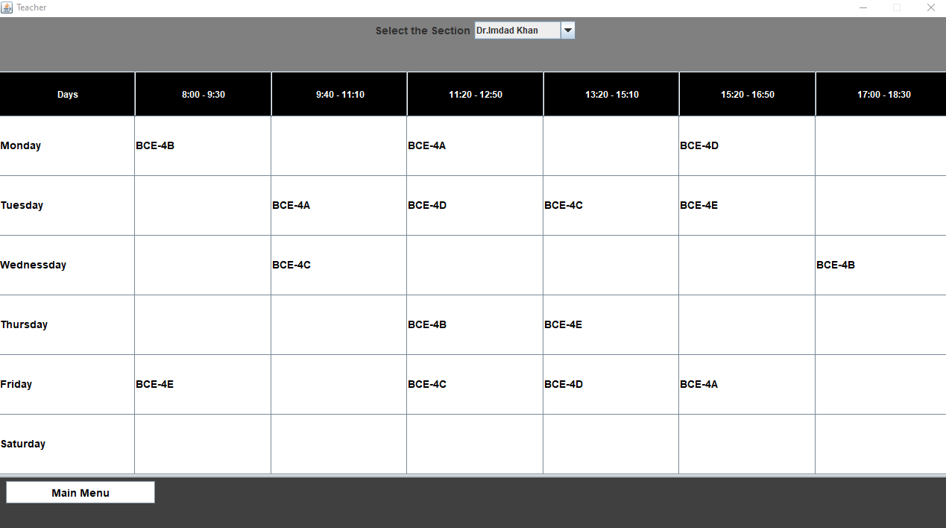
Results of Teachers Timetables:

Slide 20
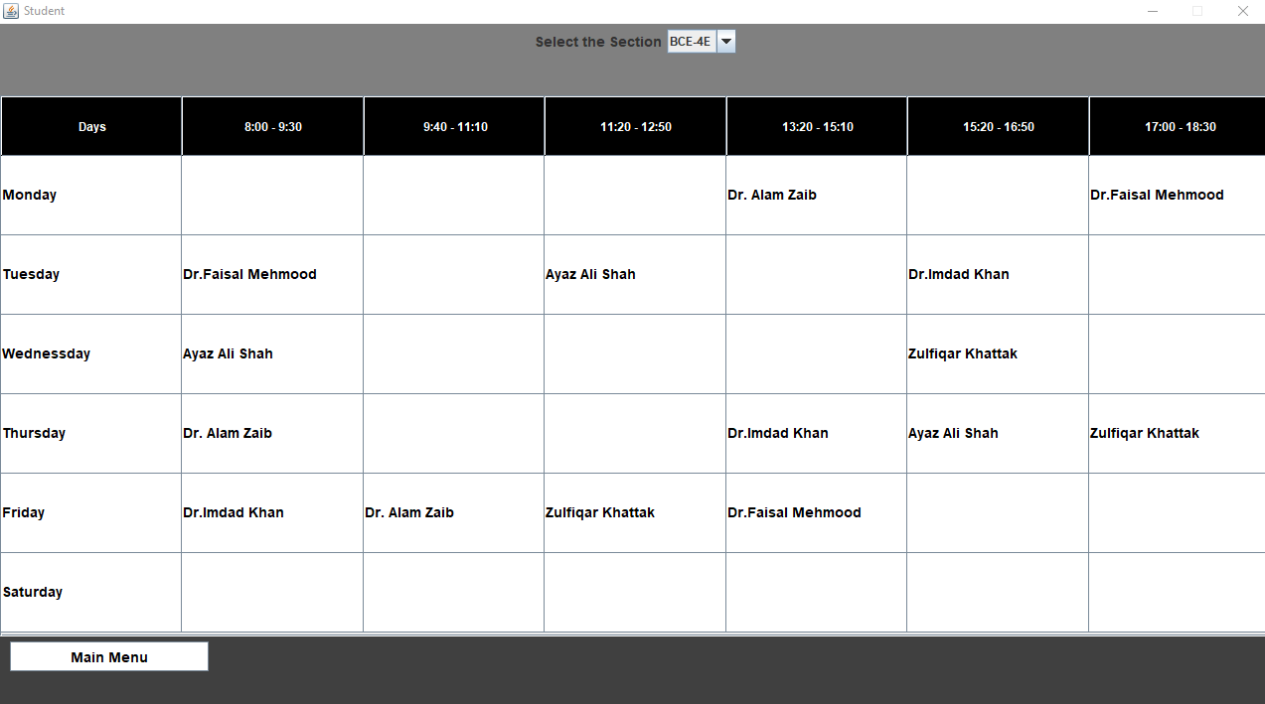
Results of Section Timetables:

Slide 21
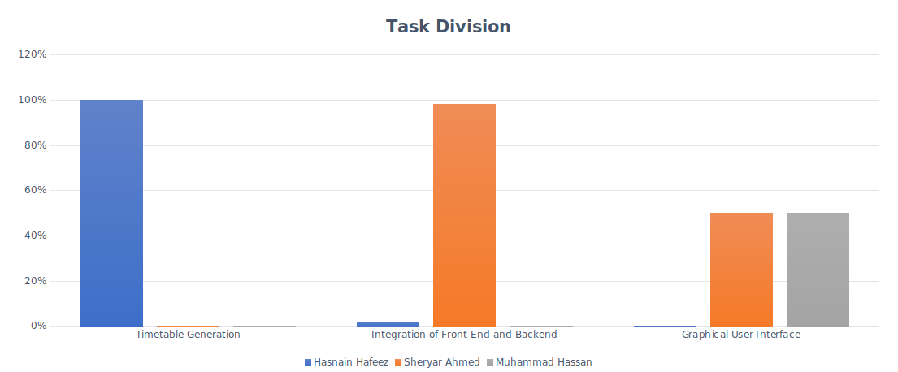
Teamwork / Task Division:

Slide 22
Timeline:

Slide 23
Learning from this project
This project provided valuable learning experiences in the following areas:
We learned how to divide a larger problem into a number of smaller problems and solve them accordingly.
We learned that teamwork is essential for solving complex engineering problems.
We learned that it takes a lot of effort to develop even the basic programs that we often overlook.

Slide 24
Conclusion:
This project was time consuming in a sense that we had to develop ideas as well as the logic to implement them.
The major task was that of the timetable generation with 100% accuracy and making it resource efficient as possible according to our knowledge.
Creating a simple yet interactive Graphical User Interface was also a huge challenge with different interfaces such as Administration, Teachers, and Students.
With teamwork and guidance of our supervisor, we have achieved these tasks.
There is a basic program, and we can add a lot more functionalities in it in the future.

Slide 25
Thank You

